Slide 1
Designing an Assessment System
Richard P. Phelps
International Research-to-Practice Conference
Nazarbayev Intellectual Schools AEO
Astana, Kazakhstan
October, 2016

Slide 2

“If a thing exists, it exists in some amount. If it exists in some amount, then it is capable of being measured.”
−−René Descartes,
Principles of Philosophy, 1664
Notes:
Some argue that learning is not measurable. When I hear this, I think of what Descartes’ said. How can one know that something exists, if one cannot somehow measure it?
Not surprisingly, Descartes ran into trouble with some religious authorities.

Slide 3
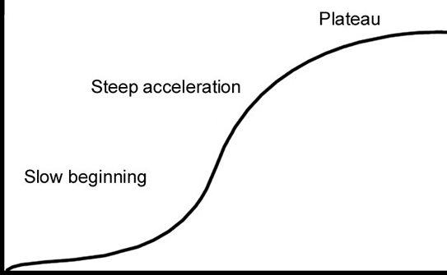
Learning Curve
Notes:
We may all be familiar with the Learning Curve. It illustrates two points: 1) that learning occurs over time, and 2) learning is not typically a linear process.

Slide 4
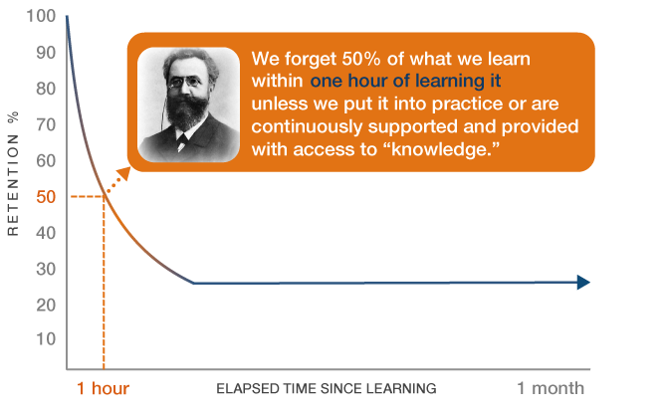
Forgetting Curve (1870s)
Notes:
The forgetting process is similar: it takes time, and is not linear. The German psychologist, Hermann Ebbinghaus, proposed that we forget about half of what we learn within one hour unless we either use the knowledge or refresh our exposure to it.

Slide 5
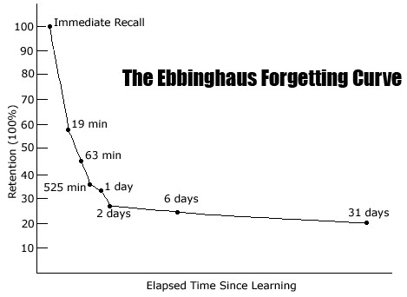
Notes:
Ebbinhaus’ conducted his first experiments on himself, testing himself on various bits of knowledge at predetermined intervals. He found that his memory discarded most information within a day. But, information remembered after a day was typically remembered for much longer.

Slide 6
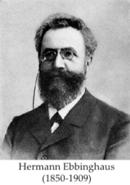
Ebbinghaus:
“Learning usually requires rehearsal
or repetition”
Notes:
Apparently, repeated retrieval of information reinforces the “need” for our brains to store the information in long-term memory.

Slide 7
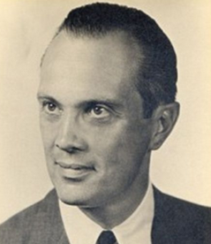
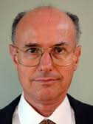
Working Memory Capacity
George Miller, 1950s
Cognitive Load Theory
John Sweller, 1980s
Notes:
In more recent years, two other psychologists have added to our understanding of learning.
The American, George Miller, along with others, introduced the concept of “working memory” in the 1950s.
And, the Australian, John Sweller, invented the term “cognitive load” in the 1980s.

Slide 8
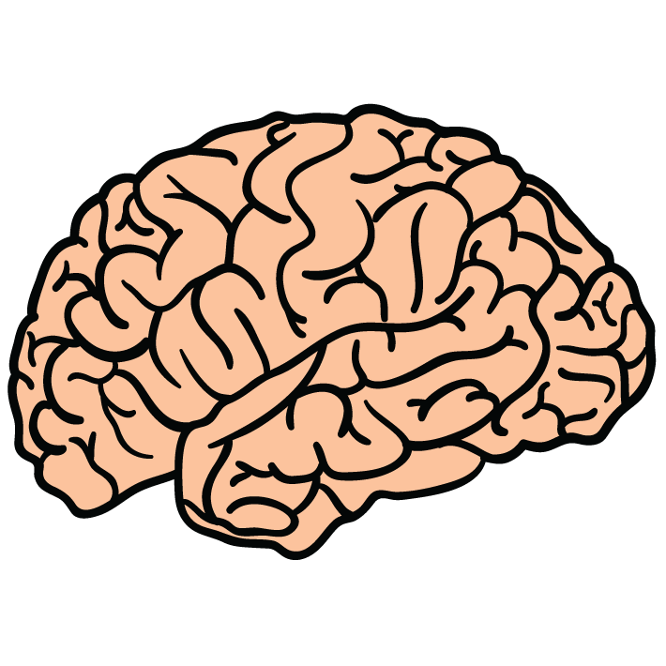
Working Memory:
Ability to temorarily hold and manipulate information for cognitive tasks
Working Memory is challenged by:
new, unfamiliar information and
quantity of discrete bits of information
Notes:
Psychologists believe that Working Memory can hold 5 to 7 “chunks” of information at a time; Without saving the information in long-term memory, or refreshing exposure to it, the 5 to 7 chunks endure for only about 10 seconds.
Working Memory has very limited capacity; Long-term memory has virtually unlimited capacity
So, we increase learning by facilitating the “transfer” of information from working memory to long-term memory

Slide 9
I am thinking of a type of object, what is it?
Description 1:
They are shapes, geometric plane figures, polygons, quadrilaterals, and parallelograms with opposite equal acute angles, opposite equal obtuse angles, and four equal sides
Notes:
I now will describe a type of object to you in two different ways – both accurate. Here I describe the object type with text. Some of you will identify the object, but please don’t say anything to others; let them think on their own.
“The objects are shapes, geometric plane figures, polygons, quadrilaterals, and parallelograms with opposite equal acute angles, opposite equal obtuse angles, and four equal sides.”
This first description challenges your working memory with high cognitive load – with multiple discrete bits of information to process simultaneously, It seems like too much information.

Slide 10

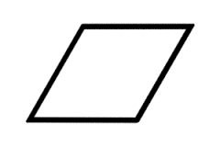
I am thinking of a type of object, what is it?
Description 2:
Notes:
Alternatively, I can just show you the objects. This second description imposes little cognitive load. The first description used text to describe an object that we typically, and more efficiently, remember visually.
Different types of information can be processed more or less easily or quickly, and this varies across people and types of information, such as words, numbers, images, sounds, colors, flavors, and odors.

Slide 11
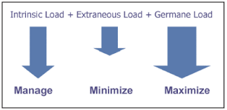
Notes:
Psychologists identify 3 types of cognitive load:
Intrinsic CL is inherent to the task, the base level of challenge that must be met
Extraneous CL is difficulty that is added by the manner in which the information is presented, the text in the previous example
Germane CL is constructing new schemas—ways of remembering this type of information—or “automating” the schemas. Examples of successfully automated schemas are riding a bicycle, driving a car, or reading text. Activities we learn to do automaticially.

Slide 12

Two centuries of research on learning concludes…
“…repeated retrieval during learning is the key to
long-term retention.”
— Henry L. “Roddy” Roediger
Notes:
Except for a few extraordinary individuals, human memories are limited and selective, and require a process for discarding most and storing only some information in long-term memory. Many of the more recent experiments took place at my undergraduate university, pictured here at about this time of year, Washington University in St. Louis.
This quotation here from Psychology Professor Roddy Roediger is quite similar to the one cited earlier by Hermann Ebbinghaus.

Slide 13
Cognitive Scientists’ 6 Strategies for Effective Learning
Retrieval Practice
Spaced Practice
Dual Coding
Interleaving
Concrete Examples
Elaboration
Notes:
Some have summarized cognitive psychologists’ experimental findings about learning into 6 categories. I will refer only to the first two in this talk.
Illustrations of all six strategies are available for free and in several forms, such as slides and posters. The posters are already available in several languages. I hope that they will also be made available in Kazakh and Russian.

Slide 14



Retrieval Practice
Notes:
The first of the six strategies is called Retrieval Practice. “Retrieval Practice” is a euphemism for testing, of any kind, including self testing or peer testing. Cognitive scientists invented the term in order to appeal to those educators with negative feelings toward testing.
The main characteristic of retrieval practice is that you search for the information internally; you “generate” it yourself. Retrieval is more difficult than review. That may be why it works better for forming long term memories. One theory is that retrieval is an active process—the brain must actively search for the information inside the store of memories—whereas reviewing instructional materials is passive—the information is stored on the textbook page and one observes it with one’s eyes, but doesn’t necessarily store the information.

Slide 15
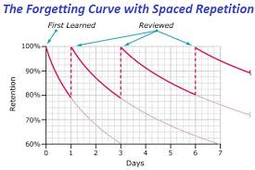
Notes:
Not only does repeated retrieval create more durable memories, retrieval works best when “spaced”. Those students who wait until the last moment to study for a test are doing it all wrong. They may put in just as much total time studying as other students who space their studying over time, but they learn less.

Slide 16
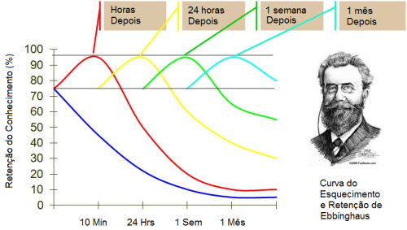
Notes:
Over time, the combination of repetition and spacing raises the level of Ebbinghaus’s forgetting curve. Optimal spacing seems to roughly follow a geometric function. In this illustration, written in Portugese, information is retrieved 1 hour later; 24 hours (or 1 day) later; 1 week later; and 1 month later. But, optimal spacing intervals vary by subject, shorter for more discrete subjects, such as mathematics, longer for less discrete subjects, such as literature.

Slide 17
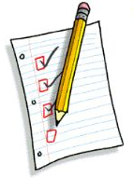
Implications for Teachers 1
Most teachers should test more frequently, …with smaller, shorter, low-stakes tests
Understand that useful assessment can be short and simple.
Notes:
The limitations of working memory support the practice of giving many small tests – continuous retrieval practice – instead of a few big tests. Each test should include some material repeated from earlier tests and, perhaps, even a little from later tests

Slide 18
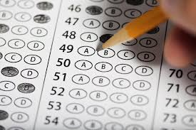
Implications for Teachers 2
Does the test format matter?
multiple-choice?
essay?
short answer?
oral?
demonstration?
…etc.?
Not so much.
Notes:
The simple act of testing is far more important than the type of test format used. Besides, each test format has advantages and disadvantages and can help in different ways. Best to use a variety, if one can.
Keep in mind, though, that some test formats – such as multiple choice – are difficult to write well, which is why they are most often found in large-scale tests. Other formats – such as essays, oral tests, or demonstrations – are difficult to administer on a large scale.

Slide 19
Implications for Teachers 3
Tests provide feedback to teachers
about what works and what does not
Just like students can learn by testing each other; teachers can help each other by reviewing each others’ tests.
Notes:
Don’t forget that testing provides information for teachers, too. It is easy to know what you are teaching. But, you can only know what students are learning if you assess.
Furthermore, assessment is an activity where teachers can help each other, by reviewing each others’ tests and helping each other write test questions, for example.

Slide 20

Cognitive Psychology experiments were conducted with “formative” tests in schools and classrooms
Notes:
The cognitive psychology experiments discussed before were typically small scale.
What about large-scale, systemwide tests? Where do they fit in?
Systemwide tests are not expensive in monetary terms. Nor do they take very much time to administer in most cases. But, depending on certain factors, they can have a large influence on local teaching and learning, for good or ill.

Slide 21
What about systemwide, large-scale tests?
First priority:
do no harm to the formative testing programs in schools and classrooms
Notes:
Unless all classrooms in an entire system operate in ”lockstep” – always exactly the same topics being covered at the same time, in the same sequence throughout an entire state or nation …System efforts at formative testing will interfere with local efforts.
Systemwide Tests should address system needs and leave formative assessment – testing for learning – to teachers and schools

Slide 22
The effect of testing on student learning
12-year study, read >3,000 documents
analyzed close to 700 separate studies, and more than 1,600 separate effects
2,000 other studies were reviewed and found incomplete or inappropriate
hundreds of other studies remain to be reviewed
Notes:
Some of you may know that I conducted a systematic review of the research on the effect of testing on students achievement. It took me 12 years because I was doing the work on my own time – evenings and weekends. I read over 3,000 documents published in the 100 years to 2010.
The results are published in the International Journal of Testing.

Slide 23
The effect of testing on student learning
245 Qualitative studies
813 Surveys or Polls
640 Quantitative Studies:
Experiments:
School- and classroom-level
Multivariate studies:
Large-scale testing programs
Notes:
I included all types of research; I wanted to see the whole picture, or as much of it as possible.
Two-thirds of the quantitative studies were small-scale, focused, randomized controlled experiments. But, a large number of the rest analyzed systemwide, large-scale testing programs at the state, national, or international level.

Slide 24
Meta-analysis
A method for summarizing a large research literature, with a single, comparable measure.
( 0.5 effect size ≈ 1 grade level of learning )
Notes:
The qualitative studies were simply counted up as positive or negative regarding the effect of testing on student learning. But, the survey studies and quantitative studies could be meta-analyzed.

Slide 25
Findings from Phelps (2012):
Survey study effect sizes average >1.0
Over 90% of qualitative studies positive
For quantitative studies, univariate effect sizes positive and stronger when:
Testing more frequently
Testing with feedback
Testing with stakes
Notes:
Results of qualitative and survey studies were overwhelmingly positive regarding the effect of testing on student learning.
All three moderators—testing frequency, feedback, and stakes—showed a strong positive indfluence on effect sizes.

Slide 26

Effect of scale on testing benefits
size of study population
small +0.34 over large
scale of test administration
small-scale +0.14 over large-scale
responsible level of government
local tests +0.29 over state tests
Notes:
Some other moderators in the meta-analysis relate to scale, measured 3 different ways, by the size of the study population, the scale of the test administration, and the level of government sponsoring or administering the test.
In each case, the smaller (or more local) the testing, the larger the positive effect on student learning. Granted, even large-scale tests tend to increase learning, but not nearly as well as small-scale tests can. This suggests that formative testing is optimally done at the school and classroom level.

Slide 27

Large-scale test, tight security
Notes:
Then there is the issue of test security with large-scale tests. Here is a photograph of Indian Army proctors administering a test to new recruits. Notice that the test-takers are allowed few places to hide cheating materials, and are separated by a distance unfavorable to reading others’ test answers.
One often finds very high levels of test security for professional selection tests – those already in the profession want to work with the best job candidates.

Slide 28
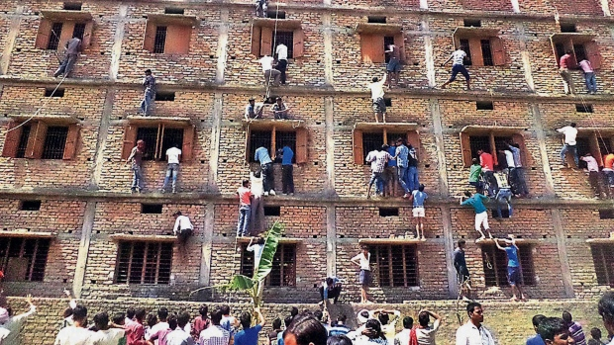
Large-scale test, lax security
Notes:
Here is another photograph from India, this time of a school. The reporter posting this photo tells us that the people climbing the walls are family members helping students inside the building with answers on a test.
This may be an extreme case but, too often, large-scale tests in education are administered with lax security. Some argue that security is needed only if the tests have high stakes. But, that is wrong. There are multiple incentives for educators to cheat on low-stakes tests; and often little reason for students to try their best on low-stakes tests. The results of any large-scale test administered without tight security should be considered suspect.

Slide 29
Besides, systemwide tests are needed for other purposes, such as…
…selection to programs with limited number of places
…monitoring and system diagnosis
…workforce planning
…accountability
…credentialing
That’s enough!
Notes:
Another reason to leave formative testing to schools and teachers is that large-scale tests are needed for several other, systemwide purposes, such as selection, monitoring, workforce planning, system accountability, and credentialing. That’s plenty. That’s enough.

Slide 30

Some large-scale test advantages
On per-student basis, inexpensive
Cognitive laboratory pre-testing possible
Standardization offers comparisons across schools and regions.
May produce high-quality items that schools and teachers can use.
MOST IMPORTANT:
provides reliable, comparative information to all those not involved in a particular school
Notes:
Moreover, there are some clear advantages to large-scale testing; I list some of the major ones here.
Note that these advantages are not automatic. For example, an education system does not capture the benefit of cognitive laboratory pre-testing unless it actually conducts cognitive laboratory pre-testing.
In my opinion, the most important benefit of large-scale testing, if administered with tight security, is that it offers students, parents, and policymakers complementary, objective evidence—evidence not provided by schools and teachers themselves. It is usually good to have a second opinion, or another point of view.

Slide 31
The more systemwide decision points, the better ?
SOURCE: Phelps, Benchmarking to the best in mathematics, Evaluation Review, 2001
Notes:
Years ago I counted the number of systemwide accountability measures used within countries scoring at the top and at the bottom on the Third International Mathematics and Science Study. Most of the accountability measures were large-scale, high-stakes tests. Countries scoring higher on TIMSS 8th-grade mathematics – represented by the blue diamonds -- used more accountability measures than the countries scoring lower – represented by the pink squares.

Slide 32
Quality control has proportionally greater effect in poorer countries
SOURCE: Phelps, Benchmarking to the best in mathematics, Evaluation Review, 2001
Notes:
I found the same relationship when I controlled for Gross Domestic Product (GDP) per capita, suggesting that the accountability effect is independent of country wealth.

Slide 33
IEA:
TIMSS, PIRLS, CIVED, SITES, ICILS, PPP, ECES, TEDS
OECD PISA:
PISA, PISA for schools
PISA for development
World Bank:
READ, SABER
…provides funding for PISA
Notes:
So, systemwide testing has benefits. But, there’s another “system” above the state or national level – and international testing is increasing in frequency and influence.
Given the proliferation, however, one wonders, how many is the right number? Is it possible there are already too many?
A national education ministry may have a good idea for a testing program, but it may be less expensive and more prestigious to join an international assessment instead, even if the international assessment is neither appropriate nor informative for the participaring nation.

Slide 34
The effect of international testing programs
school
tests
international tests
Freedom to design your testing
state and national tests
Notes:
There may also be political pressure to join an international assessment.
Here, I borrow a concept from industry analysis – that of “being stuck in the middle”. The horizontal axis is the level of government from local school to international orgainization. The vertical axis is the degree of freedom the relevant actor has to design the testing program to best suit its needs. State and national education agencies are being squeezed between important school and classroom tests, and an increasing number of international tests.

Slide 35
OECD and World Bank are run by economists
How well do economists understand PSYCHO-metrics?
Some interesting examples:
Chile’s national testing program, funded by the World Bank
OECD’s “Synergies for Better Learning” project
Notes:
Two of the international organizations involved in testing are run by economists. Economists are making psychometric decisions oftentimes without even knowing that they are psychometric decisions.
I have done some work in Chile, trying to help institutions there make adjustments to the problems caused by a poorly-designed national university admission test. Twenty years ago, Chile used a well-functioning admission test and most were happy with it. Then the World Bank decided to fund a replacement proposed by a small group of Chllean economists. The new test is far less predictive than the old test, and much less fair, The numbers of students from vocational-technical schools and low-income areas enrolling in university has sharply declined.
Elsewhere, I have written a long critique of the OECD’s 6-year, 26-country review of assessment programs, titled “Synergies for Better Learning”.

Slide 36


Some interesting oddities:
World Bank educational assessment chiefs are always Irish nationals affiliated with Boston College in the USA.
PISA is universally interpreted as an achievement test, even by the OECD. In reality, it has been an unvalidated aptitude test.
Notes:
And, consider these facts.
For decades, the key executive at the World Bank in charge of educational testing has been an Irish citizen affiliated with Boston College in the USA. This function in the World Bank is not meritocratic, it is filial. And, it has been operating this way for decades.
And at the OECD, their PISA is not an achievement test, but it is most frequently interpreted as one, even by the OECD. PISA is, and was originally intended to be, a predictive test,-- that is, an aptitude test., though the OECD has only recently begun to finance validation studies of its predictive validity.

Slide 37

Designing an Assessment System
richard {at} nonpartisaneducation {dot} org
Notes:
Thank you for your time and attention, and feel free to contact me at this email address.

